Slide 1
Intern Management System
Student names and numbers ;-
Sumit Ghatule ( 220340520101)(JUHU)
Yash Kukkar ( 220340520117)(JUHU)

Slide 2
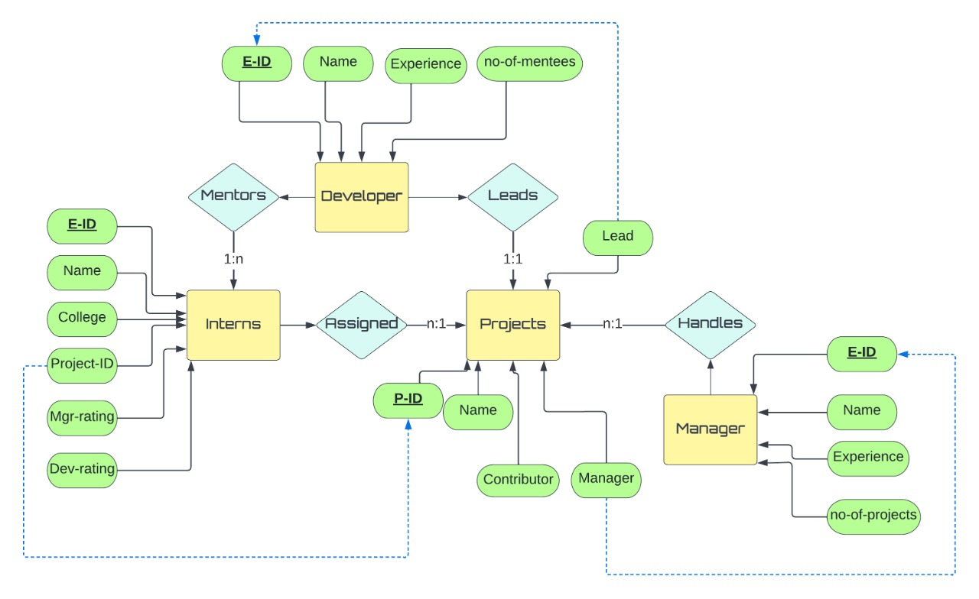
Entity Relationship - diagram

Slide 3
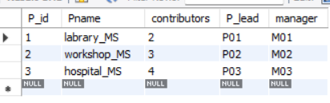
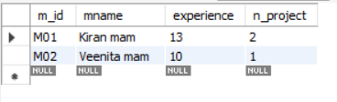
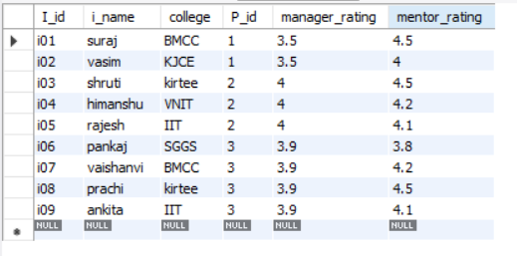
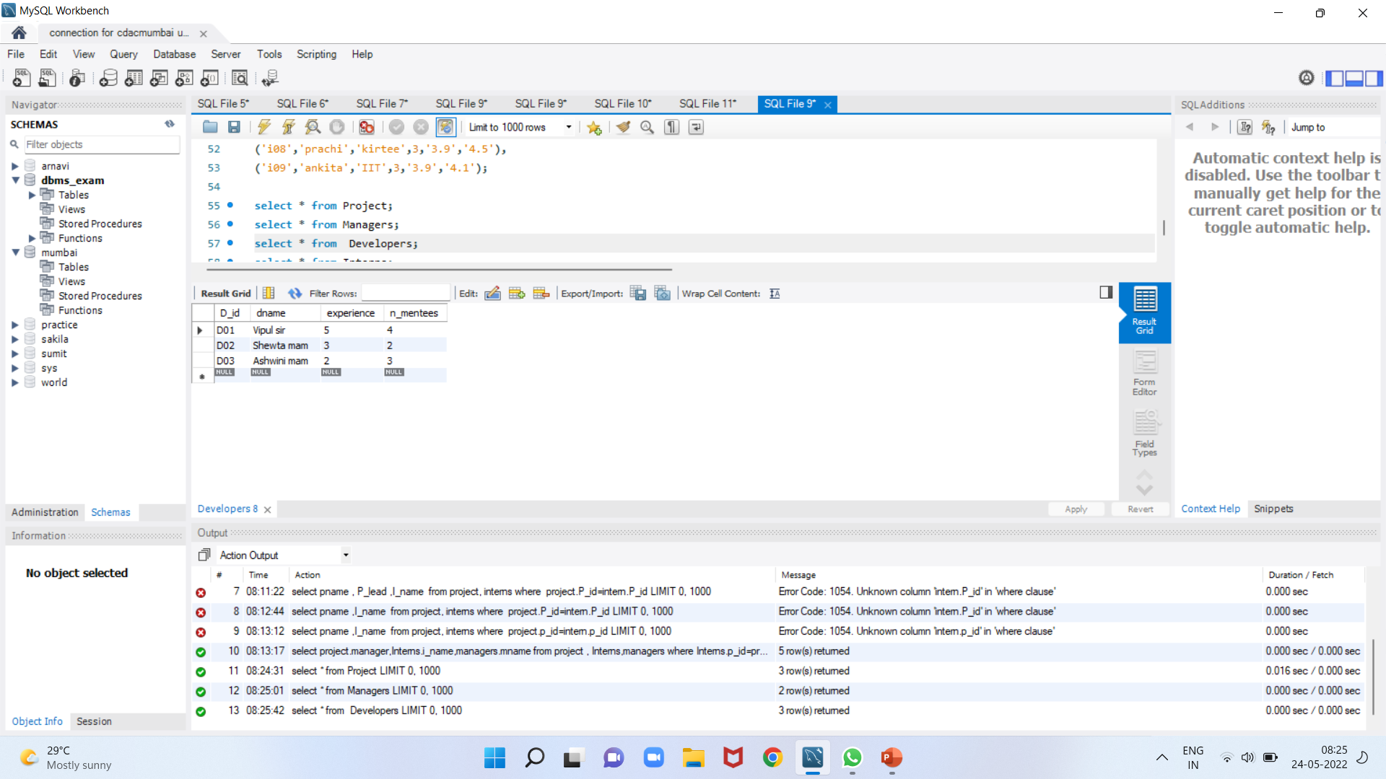
Different tables
Manager table
Intern Table
Project table
Developer Table

Slide 4
Query for table creation ;-
create table Developers(
D_id varchar(15) primary key,
dname varchar(45) ,
experience int,
n_mentees int);
insert into Developers values
('D01','Vipul sir',5,4),
('D02','Shewta mam',3,2),
('D03','Ashwini mam',2,3);
create table Interns
(I_id varchar(10) primary key,
i_name varchar(45),
college varchar(25),
P_id int,manager_rating float,
mentor_rating float);
insert into Interns values
('i01','suraj','BMCC',1,'3.5','4.5’),
('i02','vasim','KJCE',1,'3.5','4’),
('i03', 'shruti','kirtee',2,'4','4.5’),
('i04','himanshu','VNIT',2,'4','4.2’),
('i05','rajesh','IIT',2,'4','4.1’),
('i06','pankaj','SGGS',3,'3.9','3.8’),
('i07','vaishanvi','BMCC',3,'3.9','4.2’),
('i08','prachi','kirtee',3,'3.9','4.5’),
('i09','ankita','IIT',3,'3.9','4.1');
use dbms_exam;
create table Project(
P_id int primary key,
Pname varchar(15),
contributors int,
P_lead varchar(10),
manager varchar(10));
insert into Project values
(1,'labrary_MS',2, 'P01','M01’),
(2,'workshop_MS',3,'P02','M02’),
(3,'hospital_MS',4,'P03','M03’);
create table Managers(
m_id varchar(12) primary key,
mname varchar(45),
experience int,
n_project int);
insert into Managers values
('M01','Kiran mam',13,2),
('M02','Veenita mam',10,1);

Slide 5
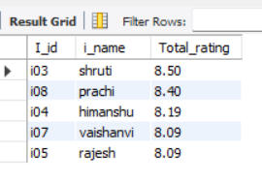
Procedure :-
A procedure to display 'n' number of Interns with highest rating .
delimiter $$
create procedure Top_Interns(n int)
begin
Select I_id, i_name, truncate (manager_rating+mentor_rating,2) as Total_rating from Interns order by Total_rating desc limit n;
end; $$
delimiter ;

Slide 6
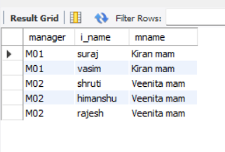
Query to manger and Interns
select project.manager,Interns.i_name,managers.mname from project , Interns , managers where Interns.p_id=project.P_id
and
project.manager=managers.m_id group by i_name ;

Slide 7
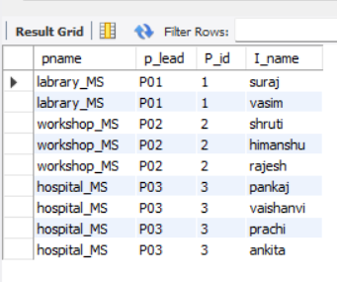
Query to Developers and Interns
select pname,p_lead,project.P_id,I_name from project,interns where project.P_id=interns.P_id;

